Slide 1
Evolving due diligence requirements
Rik Kutsch Lojenga Union for an Ethical Biotrade 15 September 2023

Slide 2
UEBT VISION A world in which all people and biodiversity thrive UEBT MISSION To regenerate nature and secure a better future for people through ethical sourcing of ingredients from biodiversity

Slide 3
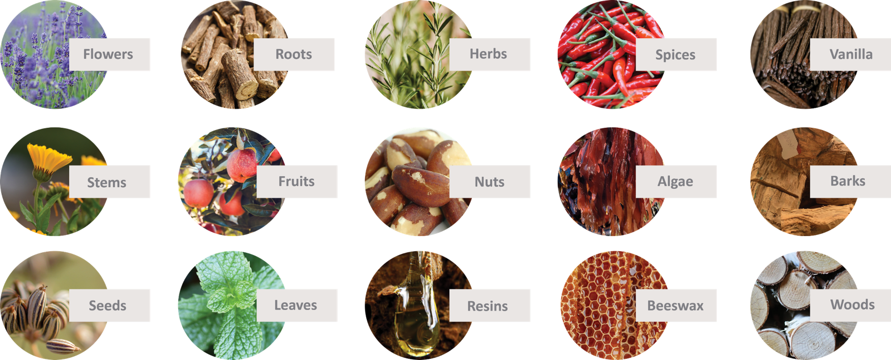
Our Focus: Botanicals
For beauty and personal care, herbal infusions, herbs and spices, functional foods & beverages, fragrances and flavours, and natural pharmaceuticals

Slide 4
The UEBT standard – Sourcing with respect
Respect for Biodiversity
Biodiversity conservation and restoration
Cultivation and wild collection practices for sustainable use of biodiversity
Respect for People
Human and worker’s rights
Community wellbeing and local development
4

Slide 5
UEBT has 174 members including:
21
Leading Brands
34
International
processors
119
Farmers, Cooperatives & Local processors

Slide 6
UEBT members commitments
1
Assess ethical sourcing policies and practices
Corporate policies and supply chain practices
2
Set targets for continuous improvement
Time-bound targets for due diligence and positive impact
3
Manage risks for people and biodiversity
Due diligence on cultivation and wild collection practices in natural raw materials
4
Promote positive impact for people and biodiversity
Improving cultivation and wild collection practices in strategic natural raw materials
5
Monitoring, reporting and communication
Monitoring of implementation and impact, with options for verification and certification

Slide 7
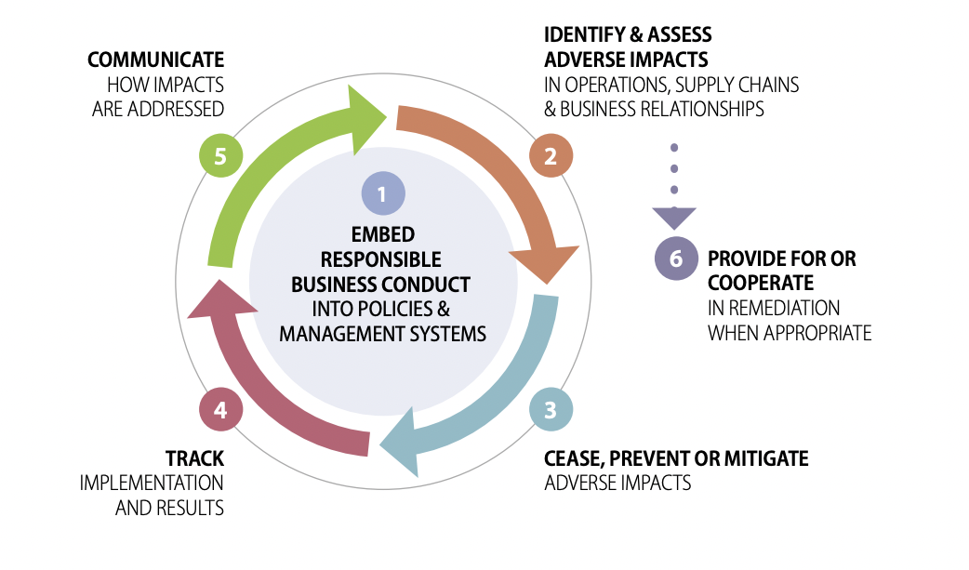
Due diligence steps (OECD)

Slide 8
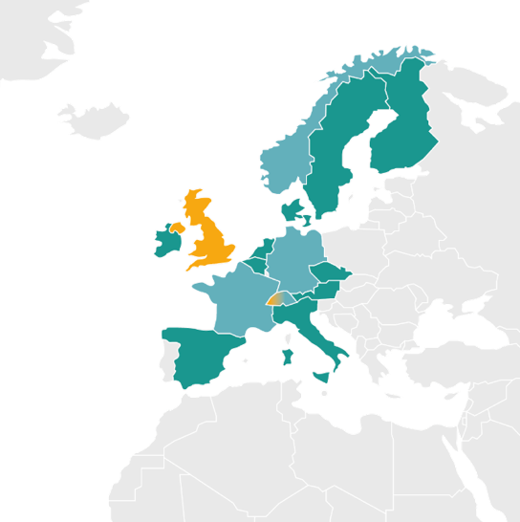
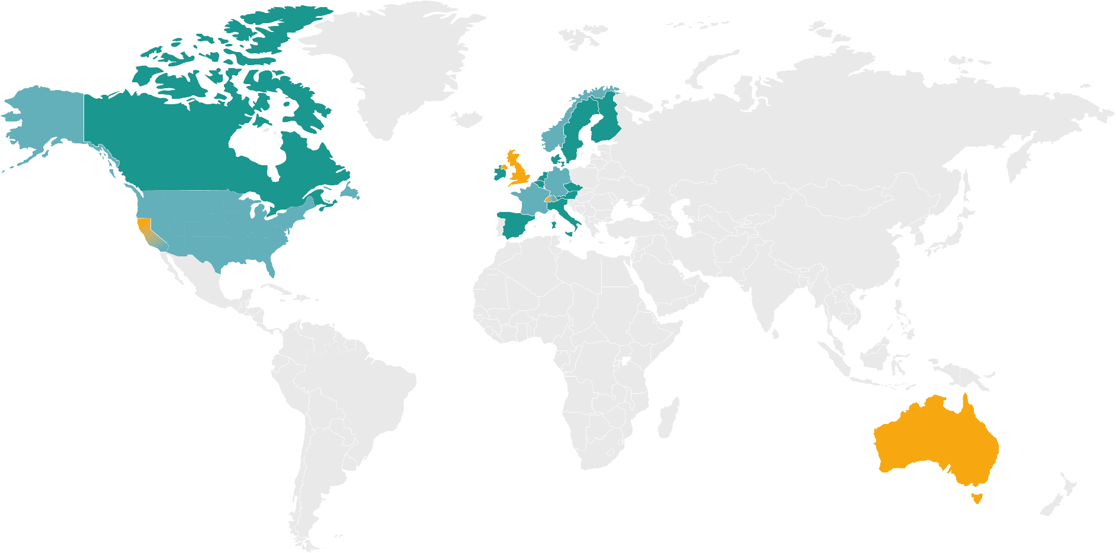
Evolving rules on due diligence
Due Diligence (With Reporting) Obligation
EU Nagoya Protocol (2014)
German Supply Chain Due Diligence Act (2020)
French Duty of Vigilance Law (2020)
Norwegian Transparency Act (2022)
EU deforestation-free products (2023)
Reporting Obligation
Australian Modern Slavery Act
California Transparency in Supply Chains Act
UK Modern Slavery Act
Swiss Non-Financial Reporting Regime
EU Corporate Reporting Directive (2021)
Proposals for Regimes Developed/Considered
Dutch Child Labour Due Diligence
Belgian Duty of Vigilance
EU Corporate Sustainability Due Diligence
Canadian Forced and Child Labour Due Diligence

Slide 9
EU corporate sustainability due diligence
Proposal 2023 (expected adoption 2024)
Risks for companies and risks for society (double materiality)
Human rights & environmental issues
Child labour Forced labour Freedom of association Occupational health and safety Minimum wage etc | Greenhouse gas emissions Pollution Biodiversity loss Ecosystem degradation etc

Slide 10
Due diligence steps (EU)
1
INTEGRATE
Including code of conduct and processes
2
IDENTIFY
Actual and potential adverse impacts on human rights and the environment, from their operations and established supply chain relationships
3
PREVENT AND MITIGATE
Action plan, contractual assurances, investment, supply chain or sectoral collaboration, termination
4
COMPLAINTS PROCEDURE
Affected persons, trade unions, civil society
5
MONITOR
Qualitative and quantitative indicators, at least every 12 months
6
COMMUNICATE
Annual statement on website

Slide 11
Implications for biotrade sector
Don’t forget human/ labour rights and the environment
Focus biotrade often on indigenous products, product development, market access

Slide 12
Challenges in botanicals
Insufficient attention paid to biodiversity conservation practices
Agrochemicals misused or overused, and waste not well managed
Farmer and picker pay is often low (below min wage) and insufficient to lift them out of poverty

Slide 13
Implications for biotrade sector
Don’t forget human/ labour rights and the environment
Focus biotrade often on indigenous products, product development, market access
Due diligence applies to all supply chains – including biotrade
Initial focus larger volumes (e.g. commodities), but smaller ingredients also in scope
Focus is on larger companies, but SMEs are not off the hook!
SMEs will be asked to provide information to buyers!
Documentation!
Buyers need evidence on social and environmental issues
Cut and run?

Slide 14
Examples of what UEBT is doing
Risk database for natural raw materials (including biotrade)
Due diligence platform: facilitate supplier information collection
Supply chain assessments
Initiatives to address problems
Supply chain projects
Carnauba wax Brazil – working group to address ‘modern slavery’
Madagascar – sector strategy on Centella asiatica (social conditions)
Rooibos – dialogue around land conversion

